Slide 1
Bellabeat Data Analysis Capstone
Unlocking Insights from Smart Device Usage
Dhruv Dominic Mahindra

Slide 2
Project Overview
Content
Company: Bellabeat, a health-focused smart device brand for women
Objective: Analyze smart device data to uncover user behavior patterns
Goal: Provide actionable insights to guide Bellabeat’s marketing strategy

Slide 3
Data Overview
Content
Aggregated user data from smart devices
Activity data: steps, calories, active minutes (very/fairly/lightly/sedentary)
Sleep data: average sleep minutes and hours
Hourly intensity, steps, and calorie burn trends
Weight and BMI for subset of users (11 total)

Slide 4
Title: Daily Activity Summary
Content
Average daily steps: 6540 Steps
Average calories burned:94.41 Calories Burned
Average Sleep : 6.60 Hours

Slide 5
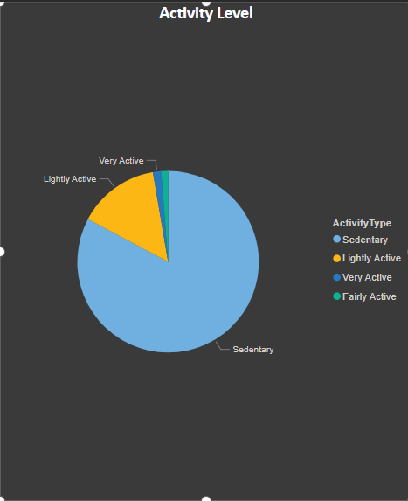
Average Activity Level
Very Active: Users spend only 1.48% of their total active time in very active movement (e.g., running, high-intensity workouts). This suggests minimal engagement in high-effort activities across the user base.
Lightly Active: On average, 14.53% of the time is spent in light activities (e.g., casual walking, household chores). While better than very active levels, it still indicates a relatively sedentary lifestyle.
Sedentary: A significant 82.79% of the time is spent in sedentary behavior — such as sitting or minimal movement. This is the dominant activity category, pointing to potentially unhealthy daily routines for most users.

Slide 6
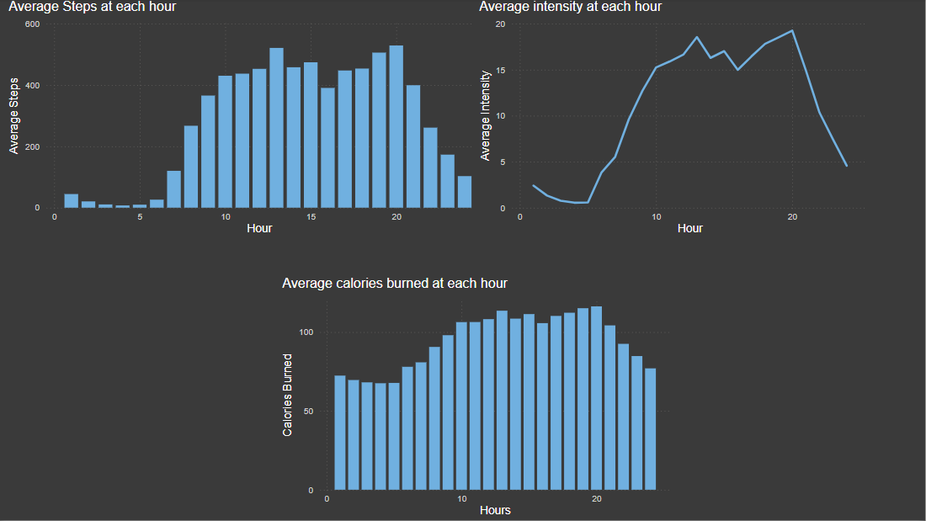
When Are Users Most Active?

Slide 7
Observations:
Visualizations indicate that all three metrics — activity intensity, calories burned, and total movement — rise sharply and align during these hours.
This overlap in the graph and line chart suggests a strong correlation between user movement and energy expenditure.
These time periods likely reflect post-lunch activity or scheduled workout sessions
Conclusion: Midday and evening are the most active hours for users. Understanding these peaks can inform targeted health nudges or activity planning to reinforce user engagement during these windows.

Slide 8
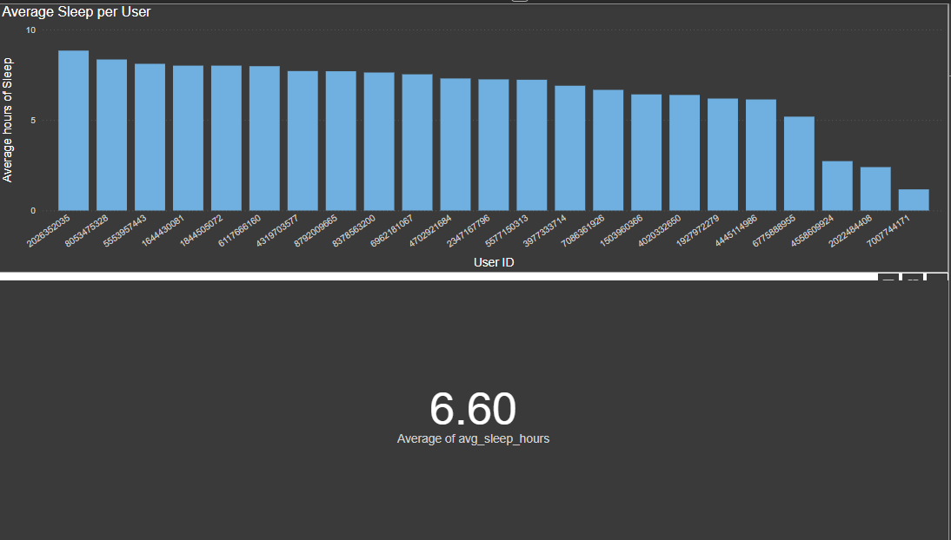
Sleep Patterns

Slide 9
Observations:
The average sleep duration across all users is 6.60 hours, which falls below the minimum healthy threshold.
The histogram visualization clearly shows that a significant portion of users sleep less than 7 hours.
Insufficient sleep can negatively impact physical health, mental alertness, and overall well-being.

Slide 10
Weight & BMI Insights
Title: Weight & BMI Insights
Content
Only 11 users provided weight data
Average weight: 73.44 kg
Average BMI: 25.73 → slightly overweight (WHO classification)

Slide 11
Key Behavioral Trends
Key Insights Summary
Low Activity Levels: Most users are either lightly active or predominantly sedentary, with minimal time spent in very active movement.
Activity Peaks Identified: User activity levels and calories burned peak around 13:00, 19:00, and 20:00, suggesting midday and evening are the most engaged hours.
Suboptimal Sleep Patterns: The average sleep duration is 6.60 hours, indicating that many users are not meeting the recommended 7–8 hours of nightly rest.
BMI Insights Point to Wellness Needs: BMI values show that most users fall within a normal to slightly elevated range, suggesting that wellness and maintenance—not aggressive weight loss—should be the focus of health interventions.

Slide 12
Marketing Recommendations
Strategic Recommendations
Target Sedentary Users Use movement nudges and habit-building challenges to encourage more active behavior throughout the day.
Promote Sleep Optimization Tools Highlight features like sleep tracking, wind-down routines, and meditation content to support better rest.
Leverage Peak Activity Hours Schedule push notifications and wellness prompts around 13:00, 19:00, and 20:00 when users are most active.
Shift Focus to Holistic Wellness Emphasize benefits like energy, mindfulness, and confidence rather than just weight loss.
Launch 30-Day Micro-Challenges Introduce monthly goals (e.g., 7k daily steps, hydration tracking, or sleep consistency) to build lasting habits.

Slide 13
Final Recommendations
Final Thoughts
Position Bellabeat as a Lifestyle Companion Move beyond fitness tracking — promote Bellabeat as a daily wellness partner supporting users’ physical, mental, and emotional health.
Leverage Data to Personalize Experiences Use behavioral insights (e.g., peak activity times, sleep patterns) to optimize content delivery and promote relevant features at the right moments.
Prioritize Sustainable Wellness Engagement Shift the brand narrative from short-term goals to long-term well-being, emphasizing balance, mindfulness, and healthy habits over time.

